Slide 1
Safety in the Auto Shop
Chapter 5

Slide 2
Auto Shop Layout
Most auto shops have four primary areas
Repair Area – includes stalls (small work areas), the alignment rack, special areas to mount and balance tires, an area for machining rotors and drums, an engine repair area, and an area to clean parts. Many stalls include a vehicle hoist.
Locker Room – is an area that includes the lunch room, lockers, sinks and wash basin, and rest room.
Tool Room – is a secure area set aside to store special tools, equipment, shop towels, and supplies.
Training or Meeting Room – this room is used for meetings, seminars, demonstrations, and other technician training activities.

Slide 3
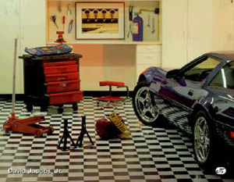
Nice Shop Stall!
The shop stall is a small work area to park a vehicle to be worked on.

Slide 4
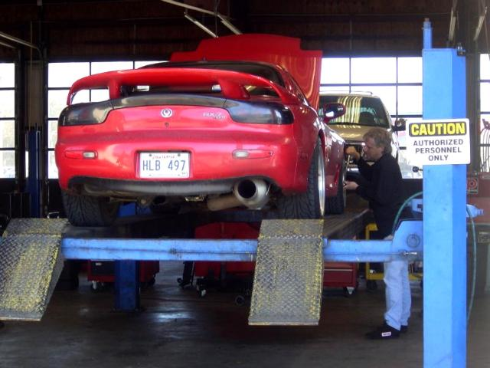
Alignment Rack

Slide 5
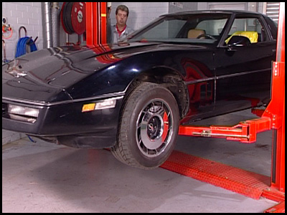
Hoist Safety

Slide 6
Hoist Safety
Rules for Using the Hoist
Ask your instructor for a demonstration
Inspect hoist for hydraulic leaks or damage
Drive vehicle onto hoist very slowly and carefully
Carefully center vehicle on hoist (by weight)
Place lift pads under lifting points of vehicle
Check ceiling height before raising vehicle
Raise vehicle a few inches off floor and recheck lift points for correct placement
Raise vehicle to desired work height and set safety latches
Be sure no one goes under vehicle during lifting and lowering. The person pushing the button is responsible for this

Slide 7
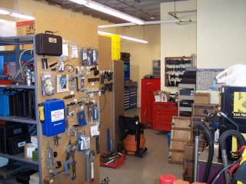
Tool Room
A secure place to store special shop equipment and supplies is the tool room

Slide 8
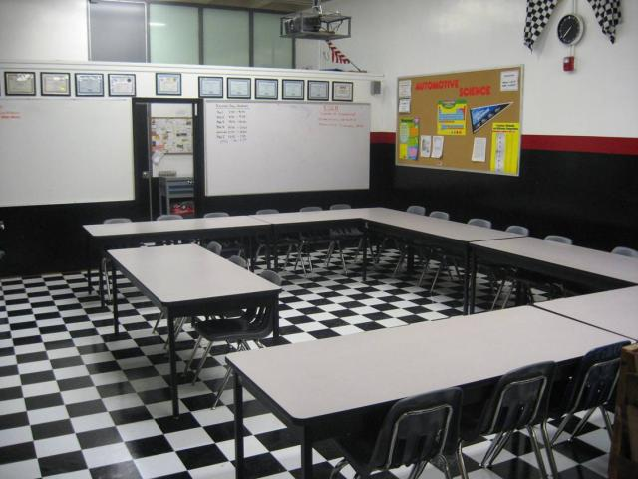
Our Training Room
The training room is a place for training, demonstrations, and other technician training events.

Slide 9
Shop Safety
General Safety Rules –
Most shop accidents occur because safety rules were not observed
When working in the shop you must look for unsafe work habits or unsafe behavior.
1. You must don safety glasses, goggles, or face shield before entering the shop.
2. Shoes must be worn in the shop. No one wearing sandals will be allowed to enter any shop area. The minimum footwear must cover the entire foot.
3. Do not operate any equipment unless you are familiar with its operation and have been authorized to operate it. Questions regarding the use of equipment should be directed to the shop supervisor or instructor.

Slide 10
Shop Safety
Shop Rules – Continued
Shop Safety
General Safety Rules –Continued
Most shop accidents occur because safety rules were not observed
4. No work may be performed using power tools without instructor permission.
5. You must be aware of other technicians in the auto shop and concentrate on safety in order to help prevent injuries to others. In case of injury, no matter how slight, report it to the instructor immediately.
6. To avoid injury or damage to shop vehicles, shop tools should never be carried in your pocket.
7. Contact with harmful chemicals should be reported immediately. For example: Asbestos sometimes found in brake and clutch dust is known to cause cancer.

Slide 11
Shop Safety
Shop Rules – Continued
Shop Safety
General Safety Rules –Continued
Most shop accidents occur because safety rules were not observed
8. Machines must be shut off and unplugged, before servicing.
9. Do not wear ties, loose clothing, jewelry, gloves, etc. when operating shop equipment.
10. Wear appropriate clothing for the job (i.e. do not wear short sleeve shirts or short pants when welding).
11. Do not work in the shop if you are tired, or in a hurry.
12. Never indulge in horseplay in the shop areas.
13. All machines must be operated with all guards and shields in place.

Slide 12
Shop Safety
Shop Rules – Continued
Shop Safety
General Safety Rules –Continued
Most shop accidents occur because safety rules were not observed
14. Never work under a vehicle not supported by jack stands!
15. Never use a rag near moving parts
16. Do not strike a hardened tool or any machine with a hammer.
17. Practice cleanliness and orderliness in the shop areas. Use a broom, mop, or the shop vacuum cleaner. Clean-up before you leave!
Remember, the radiator fan can turn on automatically
on some cars, even when the key is turned off!

Slide 13
Shop Safety
Shop Rules – Continued
Shop Safety
General Safety Rules –Continued
Most shop accidents occur because safety rules were not observed
18. Keep the floor around machines clean, dry and free from trip hazards. Do not allow clutter to accumulate. Use the shop vacuum cleaner.
19. Think through the entire job before starting.
20. Before starting a machine, always check it for correct setup and always check to see if the machine is clear.
21. Do not bring food/snacks into the shop.

Slide 14
Shop Safety
Shop Rules – Continued
Shop Safety
General Safety Rules –Continued
Most shop accidents occur because safety rules were not observed
22. Don’t rush or take chances. Obey all safety rules.
23. If you have not worked with a particular material before, check the material safety data sheet (M.S.D.S.) for any specific precautions to be taken while working with the material. Also, ask the shop personnel before cutting any unusual material.
24. Follow all appropriate precautions when working with solvents, paints, adhesives or other chemicals. Use appropriate protective equipment. Review the M.S.D.S.

Slide 15
Shop Safety
Shop Rules – Continued
Shop Safety
General Safety Rules –Continued
Most shop accidents occur because safety rules were not observed
25. Check the condition of power cords and plugs on portable tools before using them. Do not use a tool that has a worn or damaged power cord/plug.
26. Remember, running engines: get hot and can cause burns, have moving belts and pulleys which can catch on loose clothing or hair, and create deadly carbon monoxide gas which can cause asphyxiation.
USE THE SHOP VENTILATION WHEN RUNNING VEHICLES!
27. Always store oily rags in an approved metal container.
28. Any safety related questions should be directed to Mr. Bloom or Mr. Kessel.

Slide 16


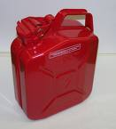

Shop Safety
Types of Hazards - Fires
Gasoline is typically the most dangerous flammable liquid found in the auto shop!
Use a Class “B” Fire Extinguisher on gasoline fires

Slide 17
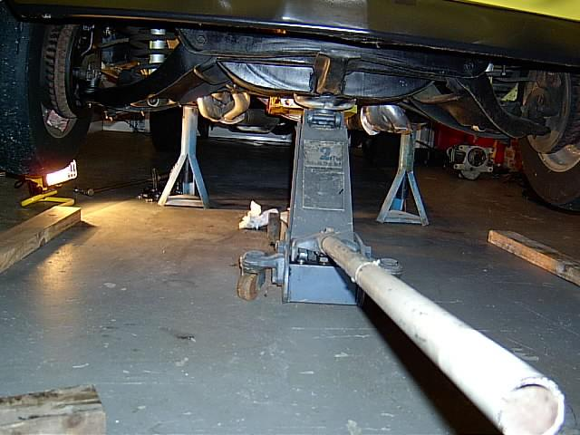




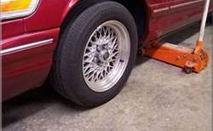

Shop Safety
Types of Hazards - Tripping
Floor Jack handles should be kept up not down to avoid trip hazards

Slide 18
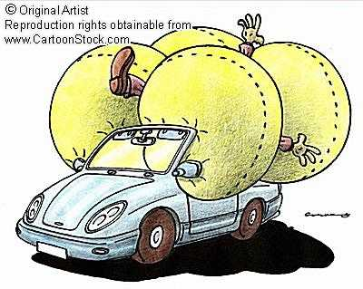

Shop Safety
Types of Hazards – Air Bags
When handling or transporting an automobile air bag, always point the metal body down and away from your body!

Slide 19
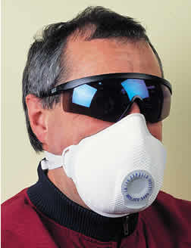

Shop Safety
Types of Hazards – Air Particulates
Technicians should wear a particle mask when working around airborne particulates

Slide 20

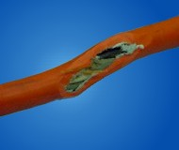
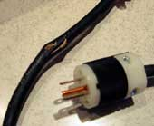
Shop Safety
Types of Hazards – Electrical
The ground wire on electric power tools prevents electrical injury to the operator
If missing or broken report to your instructor
Frayed or damaged wiring should be reported as well

Slide 21
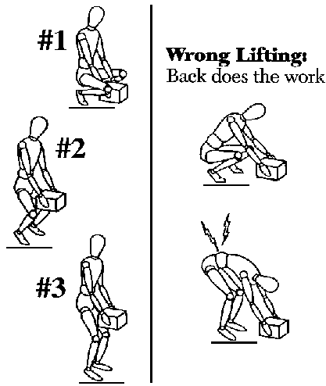

Shop Safety
Types of Hazards – Lifting
A technician should always lift with the legs and not the back!

Slide 22
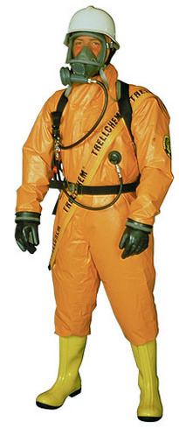
Shop Safety
Types of Hazards – Chemicals
To safely handle toxic, caustic, or corrosive materials a technician should wear:
Eye protection
Respirator
Chemical proof apron or suit
Rubber gloves
Leather/Rubber shoes

Slide 23
Shop Safety
Types of Hazards – Running Engines
Rotating belts & pulleys can catch loose clothing, jewelry, hair, and any other loose objects and drag them into the fan or pulleys.
Hot components like the exhaust system and the hot radiator can cause severe and painful burns.
Noxious fumes can lead to nausea and or carbon monoxide poisoning.

Slide 24
Shop Safety
Preventing Accidents to Avoid Injuries
The following types of accidents are very preventable if everyone is paying attention to safety:
Fires
Explosions
Asphyxiation
Chemical Burns
Electric Shock
Physical Injuries
All accidents should be reported to the instructor at once!

Slide 25
Shop Safety
Summary - General Safety Rules
A technician should always wear eye protection when working in the auto shop.
Shop tools should never be carried in your pocket.
Asbestos is often found in brake and clutch dust and is known to cause cancer.
Never work under a vehicle not supported by jack stands.
The electric radiator fan can turn on automatically on some cars, even when the key is turned off.
The shop ventilation fan should be turned on any time a vehicle is running in the shop.

Slide 26
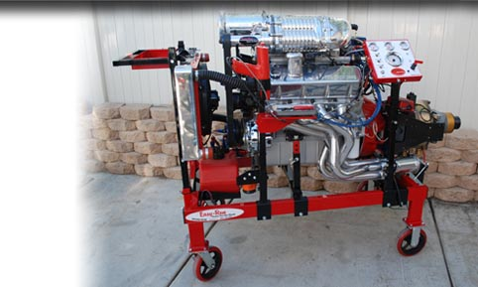
Running Engines
Remember, running engines: get hot and can cause burns, have moving belts and pulleys which can catch on loose clothing or hair, and create deadly carbon monoxide gas which can cause asphyxiation.

Slide 27
Questions?
Check the textbook chapter 5 for any questions you still need answered.
Check with at least three other students to try and find the answers you are missing.
Finally, Check with the instructor to learn where you can go to find the answers you still need.

